Slide 1

Demystifying Data Science
Jin Yu, PhD
Senior Data Scientist
Microsoft Data Insights

Slide 2
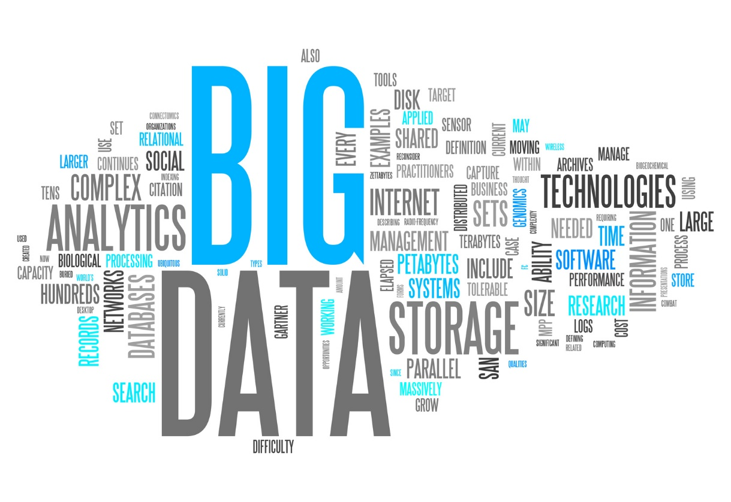

What IS Data Science?
An interdisciplinary field involving extracting insights from data in various forms
Is where Machine Learning
meets the real world
Source: Drew Conway

Slide 3




Data Science Goes Beyond BI
Historical Analytics
Predictive Analytics
Prescriptive Analytics
Highly structured, homogenous data, in a predictable schema
Structured and unstructured data at much larger volumes
Structured and unstructured data at much larger volumes
So that’s what happened…
So that’s what’s going to happen…
So this is what I should do…
The system uses data sources, business rules and models to deliver ADVICE or take ACTION
Consumed with reporting tools, dashboards and apps but relies on the user to take action
Consumed with reporting tools and relies on the analyst to take action
So that’s what the system did…

Slide 4
Data Science on the Cloud
Cortana Intelligence Suite
Information Management
Big Data Stores
Machine Learning and Analytics
Intelligence
Data Sources
People
Data Factory
Data Lake Store
Machine Learning
Cognitive Services
Data Catalog
SQL Data
Warehouse
Data Lake Analytics
Bot Framework
Web
Apps
HDInsight
(Hadoop and Spark)
Event Hubs
Cortana
Mobile
Apps
Stream Analytics
Bots
Dashboards & Visualizations
Sensors and devices
Power BI
Automated Systems
Data
Intelligence
Action

Slide 5
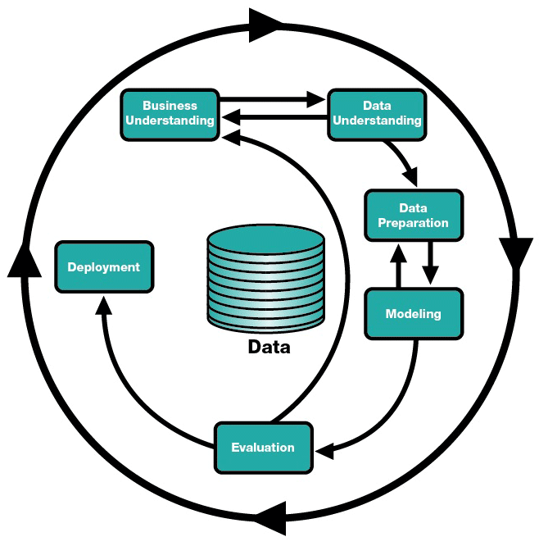
It Takes a Process
Cross-Industry Standard Process for Data Mining (CRISP-DM)*
*Source: CRISP-DM Consortium, “CRISP-DM 1.0. Step-by-Step Data Mining Guide,” 1.0 Edition, SPSS, 2000.

Slide 6
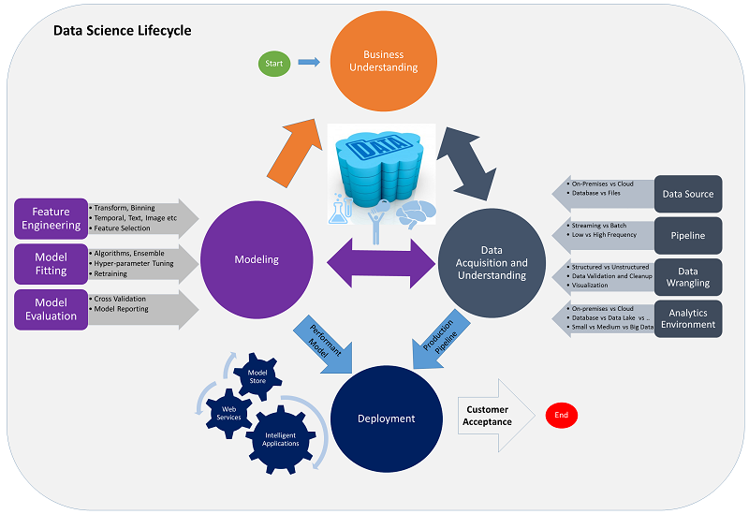
A More Granular View
Microsoft Team Data Science Process

Slide 7
Build Business Understanding
Begin with the exploration of a problem
“We spend a lot of money to acquire and retain customers. Turning over a customer, or reacquiring them is also expensive.”
Define business goals with “sharp” questions that can be answered by Data Science:
How much or how many? (regression)
Which category? (classification)
Which group? (clustering)
Is this weird? (anomaly detection)
Which option should be taken? (recommendation)
Arrive at an analytical question that addresses the problem
“It would be great if we could predict whether a customer is likely to leave us next month and target them for retention.”
Understand the data required to address the problem
“We have historical data representing customer acquisition and turnover for the past n years, including all customer interactions.”
How will people or systems use these conclusions, on which devices. How will they want to consume the analytic output and what will they do with it?
Define the consumption experience

Slide 8
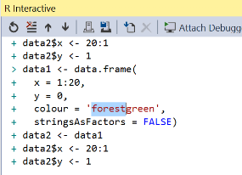
Data Prep and Modelling
Acquire data sets
Plan and locate potential sets of data. Gather data from internal and external sources
Experimentation may cause re-visitation of data understanding or even the business problem
Data prep tasks can be repeated multiple times
Rigorous model evaluation
Explore and transform the data
Using data transformation tools and engineering techniques, mine, extract, clean, mark up, label, transform, enrich and stage data
Begin the modelling experimentation
Feature engineering, model fitting, model evaluation on “unseen” data

Slide 9
Deploy and Monitor Performance
Model deployment/ operationalization
Systematic integration into dashboards, systems, applications including continued data ingestion and training
Move beyond “experimentation” into production
Integrate into dashboards, apps and acquire new data sets
Monitor performance accuracy
Revisit the modelling stage to refine the model as needed
Continuous monitoring of model performance, refine model based on field feedback, retrain model on new data
Monitor performance

Slide 10
Success Ingredients for a Data Science Project
Know your problem
Is there a clear business need?
Is the outcome measurable?
Is there data to support the business scenario? What are the caveats? Data exploration and validation are essential.
Know your data
Which types of models can answer the business question? Is it a regression, classification, anomaly detection, clustering, recommendation, or other problem?
Build relevant models
Integrate with business
Trust building through testing and validation, then deploy

Slide 11
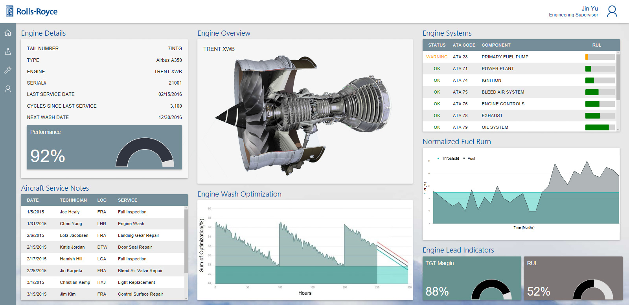
Case Study: Predictive Maintenance

Slide 12
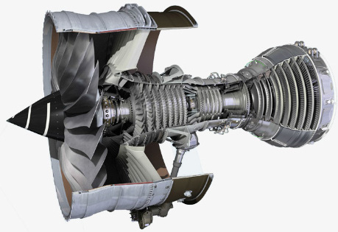
Know your problem
Is there a clear business need?
Is the outcome measurable?
Early detection of aircraft engine failures with the goal of reducing unscheduled maintenance by X%
(recall >= X%)
Know your data
Is there data to support the business scenario? What are the caveats? Data exploration and validation are essential.
Ongoing ingestion of sensor data, failure and repair history, engine features, operating conditions, and pilot profiles

Slide 13
Build relevant models
Which types of models can address the business problem? Is it a regression, classification, anomaly detection, clustering, recommendation, or other problem?
Modelling Choices
Regression or Survival Analysis to predict engine Remaining Useful Life (RUL)
Multiclass classification to predict engine failures within various time windows (e.g. week 1-2, week 2-3, >week 3)
Binary classification to predict engine failures within a certain time frame (e.g. within a week)
Anomaly detection to find anomalous patterns associated with engine failures
Integrate with business
Generate a prioritized maintenance schedule, monitor prediction performance (e.g. false negatives) and cost savings
Trust building through testing and validation, then deploy
Azure Machine Learning predictive maintenance modelling example: https://gallery.cortanaintelligence.com/Experiment/Predictive-Maintenance-Step-2A-of-3-train-and-evaluate-regression-models-2

Slide 14

Case Study: Student Analytics
Know your problem
Know your data
Is there a clear business need?
Is the outcome measurable?
Is there data to support the business scenario? What are the caveats? Data exploration and validation are essential.
Predict student dropout risks to help educators identify at-risk students in need of intervention and support, and ultimately increase school graduation rate
Historical records of student academic performance, attendance, and behaviors, student demographics and teacher profiles

Slide 15
Build relevant models
Which types of models can address the business problem? Is it a regression, classification, anomaly detection, clustering, recommendation, or other problem?
Integrate with business
Trust building through testing and validation, then deploy
Modelling Choices
Notify educators the predicted at-risk students, monitor the impact on student performance and school graduation rates
Regression or Survival Analysis to predict time-to-dropout
Binary classification to predict student dropout the following semester
Azure Machine Learning student analytics example: https://gallery.cortanaintelligence.com/Experiment/Student-Performance-Mathematics-2

Slide 16
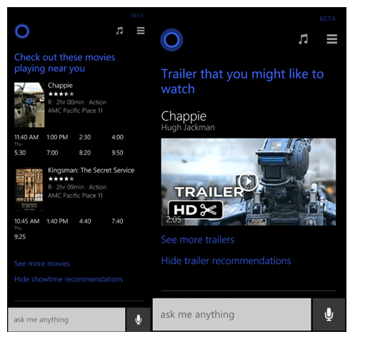
Case Study: Recommendation Engine
Know your problem
Is there a clear business need?
Is the outcome measurable?
Provide personalized movie recommendations to boost user engagement (clicks)
Know your data
Is there data to support the business scenario? What are the caveats? Data exploration and validation are essential.
User viewing history, user profiles, movie attributes (genre, rating, actors, director)

Slide 17
Build relevant models
Which types of models can address the business problem? Is it a regression, classification, anomaly detection, clustering, recommendation, or other problem?
Modelling Choices
Collaborative Filtering recommendation
Content-based recommendation
Hybrid approach
Azure Machine Learning recommendation engine example: https://gallery.cortanaintelligence.com/Experiment/Recommender-Movie-recommendation-3
Integrate recommendation engine into content delivery platform, monitor performance metrics (e.g. Recall@K, NDCG@K) and content consumption time
Integrate with business
Trust building through testing and validation, then deploy

Slide 18
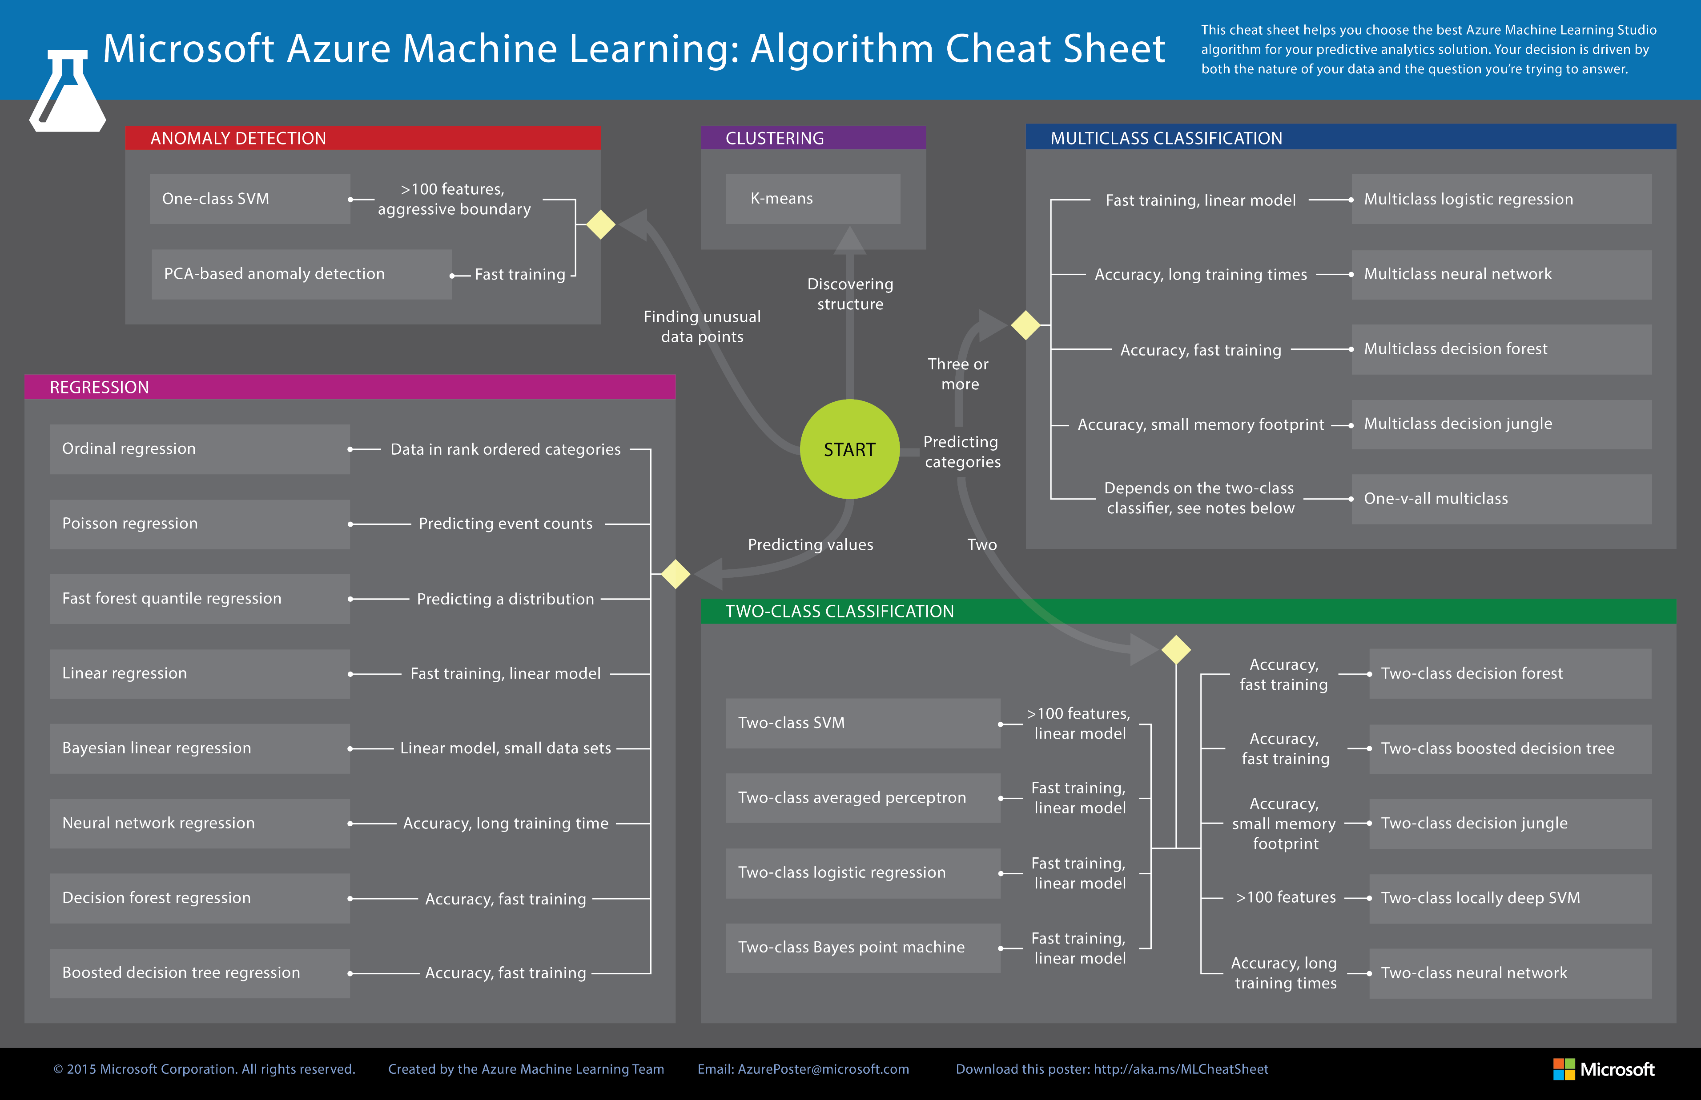
Less Coding More Experimentation

Slide 19
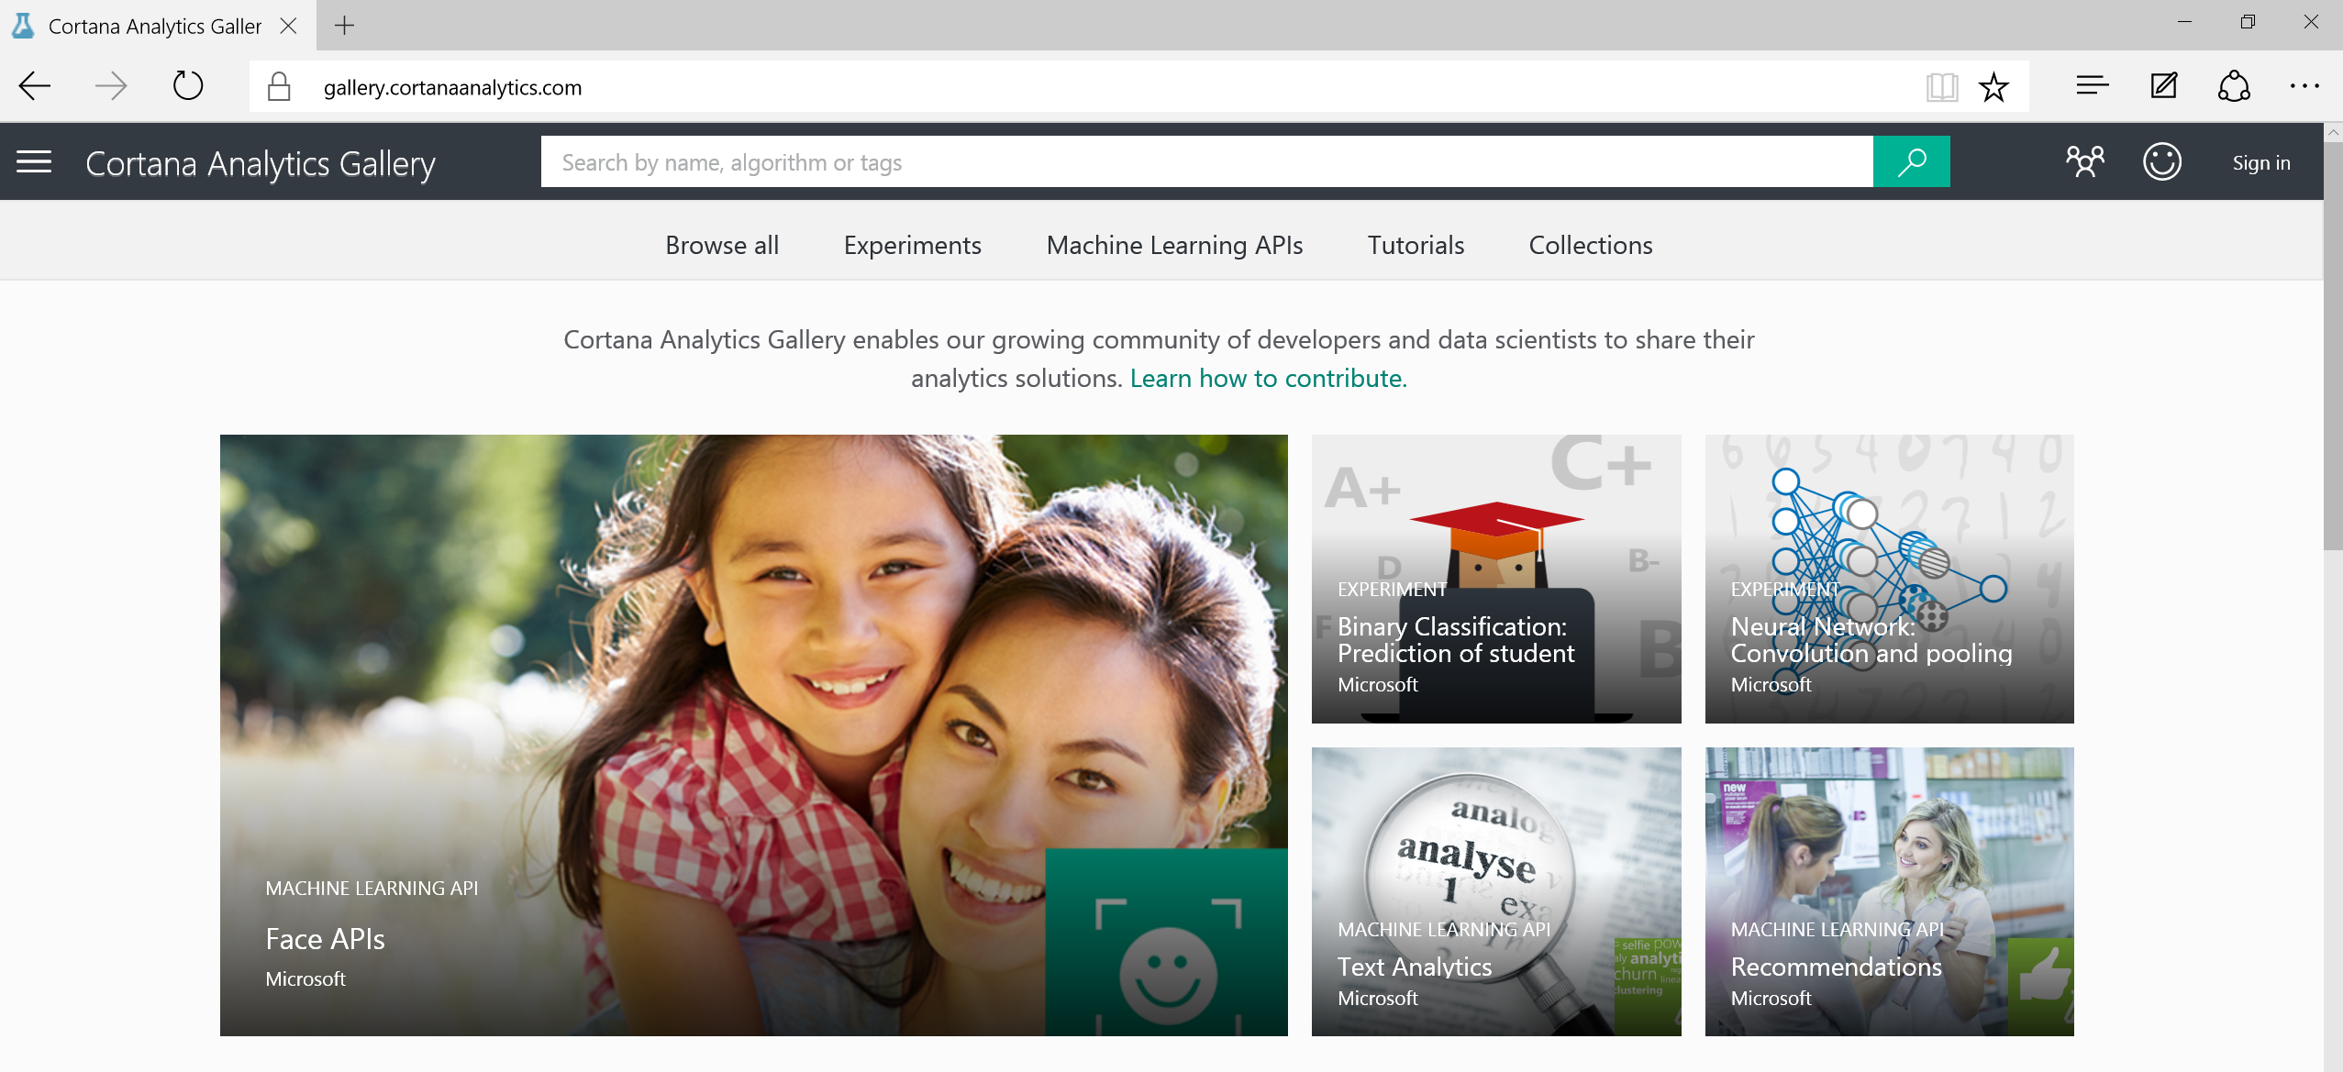
Make Other People Do Your Work

Slide 20

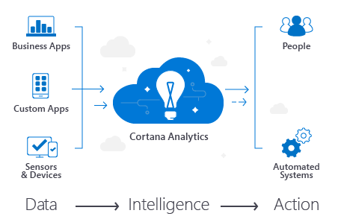
Microsoft Data Insights Services
Microsoft Services
Gather requirements
Catalog data sources
Configure orchestration and storage
Create machine learning models
Deploy and operationalize
Implement suite-solutions
Microsoft Data Insights group works with your teams to establish a pipeline for analytics using hybrid cloud technologies as well as suite-based solutions
Algorithmic Machine Learning
Storage and Transformation {Orchestration}
Organizational/External/Cloud Data Sources

